Slide 1
God’s Name
יהוה
Basic Theology #7
Caversham Community Church, Dunedin
Jeff Coleman, 13 February 2022

Slide 2
Upcoming Schedule
Basic Theology — Sundays @ 7pm
Feb 13 - God’s Name and Titles - Jeff Coleman
Feb 20 - The Trinity - Steve Reardon
Feb 27 - Special Revelation - Jacques Brown
Mar 6 - Inspiration of Scripture
Mar 13 - Defections from Inerrancy of Scripture
Mar 20 - Inerrancy of Scripture
Mar 27 - Inerrancy and the Teachings of Christ

Slide 3
God’s Name and Titles
Agenda for This Evening
Review
God’s Name
Basic Name
Revelation
Meaning
Significance
Sacredness
Characteristics
Associations
Compound Names
Application
Promises
God’s Titles
Definition
El Titles
Other Titles

Slide 4
Review: God’s Attributes

Slide 5
Definition
God’s Attributes
God’s attributes are “the inherent characteristics and qualities that identify, express, and distinguish the essential nature of who God is.”

Slide 6
General Principles
God’s Attributes
God’s attributes are essential to himself and are not standards outside himself.
God’s attributes are intrinsic, permanent, and cannot be lost.
God is all of his attributes, all the time, everywhere
God’s attributes do not conflict with one another.
Father, Son, and Spirit share these attributes equally and infinitely.

Slide 7
God Is Great
Natural Attributes
Omnipresence
Personhood
Joy
Eternity
Incomprehensibility
Omniscience
Life
Freedom
Infinity
Omni’s
Glory
Unity
Immutability
Spirituality
Transcendence
Omnipotence
Sovereignty

Slide 8
God Is Good
Moral Attributes
Truth
Wisdom
Righteousness
Compassion
Mercy
Integrity
Holiness
Kindness
Love
Faithfulness
Justice
Patience
Grace

Slide 9
God Is Great
Natural Attributes
Omnipresence
Personhood
Joy
Eternity
Incomprehensibility
Omniscience
Life
Freedom
Infinity
Omni’s
Glory
Unity
Immutability
Spirituality
Transcendence
Omnipotence
Sovereignty
God Is Good
Moral Attributes
Truth
Wisdom
Righteousness
Compassion
Mercy
Integrity
Holiness
Kindness
Love
Faithfulness
Justice
Patience
Grace

Slide 10
God’s Name

Slide 11
יהוה
YHVH
Yahweh
Jehovah
the Lord
κύριος

Slide 12
Basic Name
God’s Name
Exodus 3:13-15 13 Then Moses said to God, If I come to the people of Israel and say to them, The God of your fathers has sent me to you, and they ask me, What is his name? what shall I say to them? 14 God said to Moses, I Am who I Am (אֶֽהְיֶ֖ה אֲשֶׁ֣ר אֶֽהְיֶ֑ה). And he said, Say this to the people of Israel: I Am (אֶהְיֶה) has sent me to you. 15 God also said to Moses, Say this to the people of Israel: Yahweh (יהוה), the God of your fathers, the God of Abraham, the God of Isaac, and the God of Jacob, has sent me to you. This is my name forever, and thus I am to be remembered throughout all generations.

Slide 13
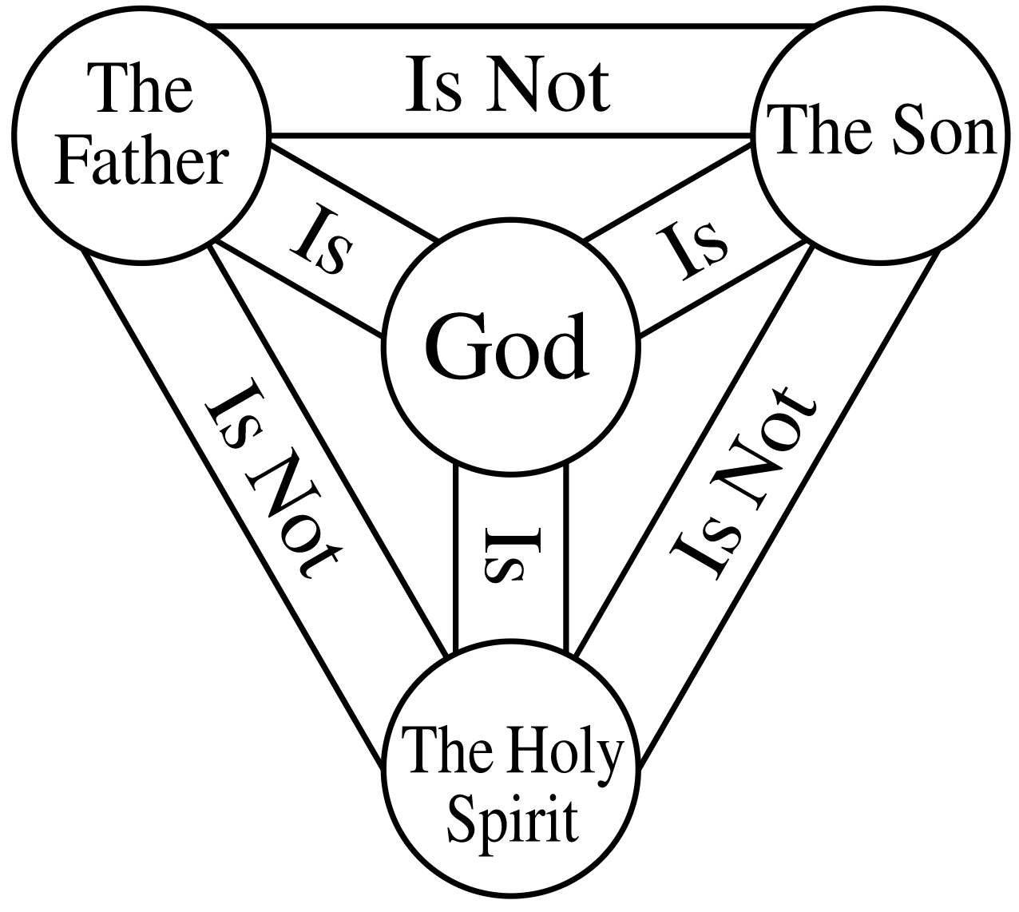
יהוה

Slide 14
Revelation
God’s Name
Exodus 6:2-3 2 God spoke to Moses and said to him, I am Yahweh. 3 I appeared to Abraham, to Isaac, and to Jacob, as El Shaddai, but by my name Yahweh (יהוה) I did not make myself known to them.

Slide 15
Meaning
God’s Name
Exodus 3:13-15 13 Then Moses said to God, If I come to the people of Israel and say to them, The God of your fathers has sent me to you, and they ask me, What is his name? what shall I say to them? 14 God said to Moses, I Am who I Am (אֶֽהְיֶ֖ה אֲשֶׁ֣ר אֶֽהְיֶ֑ה). And he said, Say this to the people of Israel: I Am (אֶהְיֶה) has sent me to you. 15 God also said to Moses, Say this to the people of Israel: Yahweh (יהוה), the God of your fathers, the God of Abraham, the God of Isaac, and the God of Jacob, has sent me to you. This is my name forever, and thus I am to be remembered throughout all generations.

Slide 16
Significance
God’s Name
Exodus 34:5-7 5 Yahweh descended in the cloud, stood with [Moses] there, and proclaimed the name of Yahweh. 6 Yahweh passed before him and proclaimed, Yahweh, Yahweh, a God merciful and gracious, slow to anger, and abounding in steadfast love and faithfulness, 7 keeping steadfast love for thousands, forgiving iniquity, offense, and sin, but who will by no means clear the guilty, visiting the iniquity of the fathers on the children and the children’s children to the third and the fourth generation.

Slide 17
Sacredness
God’s Name
Exodus 20:7 7 You shall not take the name (שֵׁם) of Yahweh your God in vain, for Yahweh will not hold him guiltless who takes his name (שֵׁם) in vain.
Leviticus 24:16 16 Whoever blasphemes the name of Yahweh shall surely be put to death. All the congregation shall stone him. The sojourner as well as the native, when he blasphemes the name (שֵׁם), shall be put to death.

Slide 18
Characteristics
God’s Name
Holy.
Ezekiel 36:22-23 22 It is not for your sake, house of Israel, that I am about to act, but for the sake of my holy name, which you have profaned among the nations to which you came. 23 And I will vindicate the holiness of my great name.
Majestic.
Psalm 8:1 1 Yahweh, our Lord, how majestic is your name (שֵׁם) in all the earth!
Powerful.
Proverbs 18:10 10 The name of Yahweh is a strong tower. The righteous one runs into it and is safe.
Blessed.
Daniel 2:20 20 Blessed be the name of God forever and ever.

Slide 19
Ark of the Covenant
House of David
Israel
יהוה
Temple
Jesus
Jerusalem
Believers
Temple

Slide 20
Associations
God’s Name
Revelation 22:3-4 3 No longer will there be anything accursed, but the throne of God and of the Lamb will be in [the new Jerusalem], and his servants will worship him. 4 They will see his face, and his name will be on their foreheads.

Slide 21
יְהוָ֣ה יִרְאֶ֑ה
Yahweh Yireh
God Will Provide
יְהוָ֥ה צִדְקֵֽנוּ
Yahweh Tsidkenu
God Our Righteousness
יְהוָ֥ה נִסִּֽי
Yahweh Nissi
God Our Banner
יהוה
יְהוָה֙ קַנָּ֣א
Yahweh Qanna
God of Zeal
יְהוָ֖ה רֹפְאֶֽך
Yahweh Ropheka
God Our Healer
יְהוָ֨ה צְבָא֜וֹת
Yahweh Tsevaot
God of Armies
יְהוָ֖ה מְקַדִּשְׁכֶֽם
Yahweh Mekadishkem
God Who Sanctifies You
יְהוָ֖ה שָׁל֑וֹם
Yahweh Shalom
God of Peace

Slide 22
Application
God’s Name
Call upon Yahweh’s name (Ge 4:26)
Bless in Yahweh’s name (Dt 21:5)
Glory in Yahweh’s name (1 Ch 16:10)
Know Yahweh’s name (2 Ch 6:33)
Love Yahweh’s name (Is 56:6-7)
Praise Yahweh’s name (Ps 145:2)
Trust in Yahweh’s name (Ps 20:7)
יהוה

Slide 23
Application
God’s Name
Give thanks to Yahweh’s name (Ps 44:8)
Wait for Yahweh’s name (Ps 52:9)
Honour Yahweh’s name (Mal 3:16)
Set apart Yahweh’s name (Mt 6:9)
Unify around Yahweh’s name
יהוה

Slide 24
Promises
God’s Name
God’s name will be proclaimed in all the earth.
Revelation 15:3-4 3 Great and amazing are your deeds, O Lord God, the Almighty! Just and true are your ways, O King of the nations! 4 Who will not fear, O Lord, and glorify your name? For you alone are holy.
God blesses those upon whom his name is placed.
Numbers 6:27 27 So shall they put my name upon the people of Israel, and I will bless them.
God pays attention to and hears those who honour his name.
Malachi 3:16 16 Then those who feared Yahweh spoke with one another. Yahweh paid attention and heard them, and a book of remembrance was written before him of those who feared Yahweh and esteemed his name.

Slide 25
God’s Titles

Slide 26
Definition
God’s Titles
God’s titles are “God’s descriptions of himself that reveal aspects of his character. They are various designations by which he is to be addressed in humility by human beings.”

Slide 27
אֵ֣ל עֶלְי֔וֹן
El Elyon
God Most High
אֵ֣ל שַׁדַּ֔י
El Shaddai
God Almighty
אֵ֥ל עוֹלָֽם
El Olam
God Eternal
אֱלֹהִים
אֵ֣ל רֳאִ֑י
El Roi
God Who Sees Me
אֲדֹנָ֤י
Adonai
My Lord
קְ֝ד֗וֹשׁ יִשְׂרָאֵֽל
Qadosh Israel
Holy One of Israel
δέσποτα
Despota
Master

Slide 28
Next Time:
The Trinity

