Slide 1
Isaiah 40
Comfort My People
Jeff Coleman, 1 February 2022
Insights in Isaiah

Slide 2
Upcoming Schedule
Tuesdays and Thursdays at Noon
Thursday, Feb 3 - Isaiah 41 - Chris N.
Thursday, Feb 10 - Isaiah 42 - Jeff C.
Tuesday, Feb 15 - Isaiah 43 - Jeff C.
Thursday, Feb 17 - Isaiah 44 - Chris N.
Tuesday, Feb 22 - Isaiah 45 - Jeff C.

Slide 3
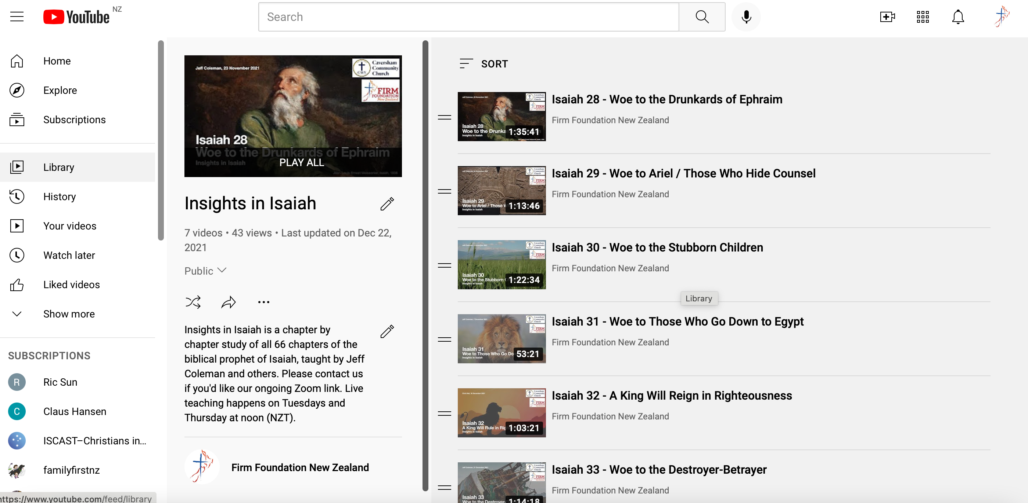
YouTube Playlist
https://www.youtube.com/playlist?list=PLC9hyRFKvtkDLpoMgxrJ1UWnySRu4iRas

Slide 4
Firm Foundation NZ Website
https://www.firmfoundation.org.nz/isaiah/

Slide 5
Isaiah at a Glance
Book Theme | Salvation for Israel and the Nations through the Messianic King-Servant-Conqueror
Author | Isaiah
Recipients | Judah and Jerusalem
Date | 739-681 bc
Message | The Messianic King will rule in righteousness over a righteous remnant from Israel and the nations, but first he must become a Servant who provides righteousness for the remnant and a Conquerer who defeats the remnant’s enemies.

Slide 6
Isaiah’s Three Big Segments
Chapters | Segment Theme
1-39 | Messianic King
40-55 | Messianic Servant
56-66 | Messianic Conqueror

Slide 7
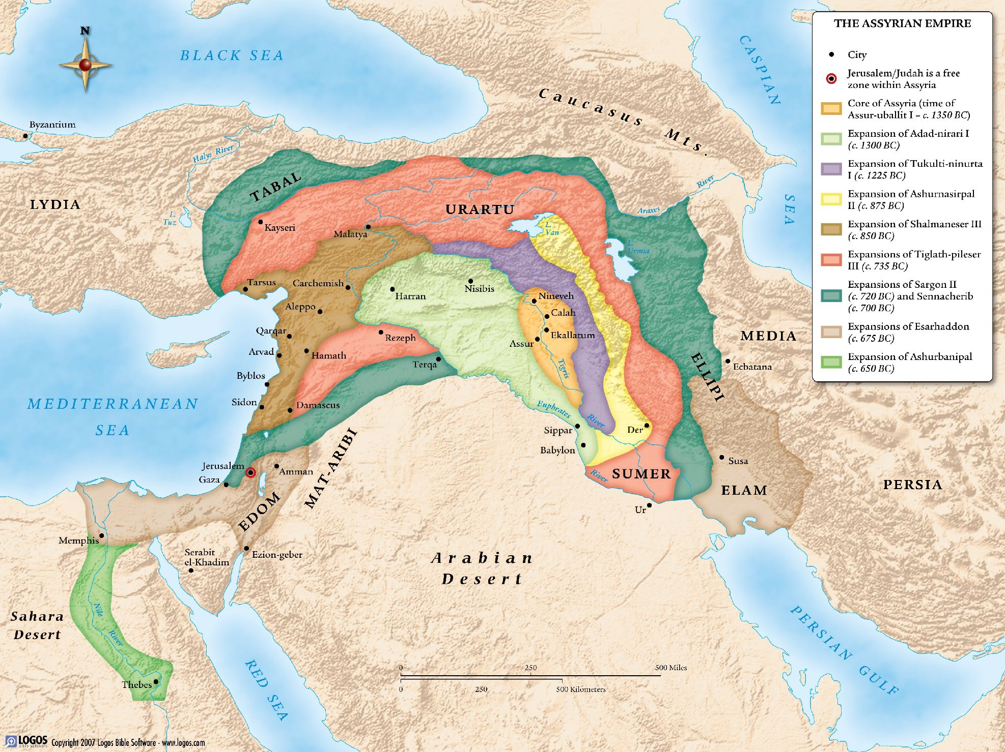

Slide 8
Comfort My People
Isaiah 40
Comfort My People (vv. 1-2)
Three Voices of Comfort (vv. 3-11)
First Voice: Prepare a Highway for Our God (vv. 3-5)
Second Voice: God’s Word Stands Forever (vv. 6-8)
Third Voice: the Gentle Shepherd (vv. 9-11)
The Incomparable Creator-King (vv. 12-26)
God Compared to the Nations (vv. 12-17)
God Compared to Idols (vv. 18-20)
God Compared to Men and Kings (vv. 21-24)
The Creator-King over the Heavens (vv. 25-26)
Wings Like Eagles (vv. 27-31)

Slide 9
Comfort My People
Isaiah 39
Is 40:1-2 1 Comfort, comfort my people, says your God (נַחֲמ֥וּ נַחֲמ֖וּ עַמִּ֑י יֹאמַ֖ר אֱלֹהֵיכֶֽם). 2 Speak to the heart of Jerusalem and cry to her that her warfare/hardship (צָבָא) is ended, that her iniquity is pardoned, that she has received from his hand double (כֶּ֫פֶל) for all her sins.

Slide 10
Three Voices of Comfort
First Voice: Prepare a Highway for Our God
Is 40:3-5 3 A voice [Isaiah’s] cries, In the wilderness (מִדְבָּר) prepare the road (דֶּ֫רֶךְ) of Yahweh (יהוה). Make straight in the desert (עֲרָבָה) a highway (מְסִלָּה) for our God (אֱלֹהִים). 4 Every valley shall be lifted up, and every mountain and hill be made low. The uneven ground shall become level, and the rough places a plain. 5 And the glory of Yahweh shall be revealed (גלה), and all flesh shall see it together, for the mouth of Yahweh has spoken.

Slide 11
Three Voices of Comfort
Second Voice: God’s Word Stands Forever
Is 40:6-8 6 A voice [God’s] says, Cry! And I [Isaiah] said, What shall I cry? All flesh is grass, and all its beauty is like the flower of the field. 7 The grass withers, the flower fades when the breath (רוּחַ) of Yahweh blows on it. Surely the people are grass. 8 The grass withers, the flower fades, but the word (דָּבָר) of our God will stand forever (עוֹלָם).

Slide 12
Three Voices of Comfort
Third Voice: the Gentle Shepherd
Is 40:9-11 9 Go on up to a high mountain (הַר־גָּבֹ֤הַ), Zion, herald of good news/the gospel (מְבַשֶּׂ֣רֶת). Lift up your voice with strength, Jerusalem, herald of good news/the gospel (מְבַשֶּׂ֖רֶת). Lift it up, fear not. Say to the cities of Judah, Behold your God! 10 Behold, Lord Yahweh (אֲדֹנָ֤י יְהוִה) comes with might (חָזָק), and his arm rules for him. Behold, his reward (שָׂכָר) is with him, and his recompense before him. 11 He will tend his flock like a shepherd. He will gather the lambs in his arms. He will carry them in his bosom and gently lead those that are with young.

Slide 13
The Incomparable Creator-King
God Compared to the Nations
Is 40:12-17 12 Who has measured the waters in the hollow of his hand, marked off the heavens with a span [of his hand] (זֶרֶת), enclosed the dust of the earth in a measure, and weighed the mountains in scales and the hills in a balance? 13 Who has measured/directed the Spirit (רוּחַ) of Yahweh, or what man shows him his counsel? 14 Whom did he consult, and who made him understand (בין)? Who taught him the path of justice (מִשְׁפָּט), taught him knowledge (דַּ֫עַת), and showed him the way (דֶּ֫רֶךְ) of understanding (תְּבוּנָה)? 15 Behold, the nations (גּוֹיִם֙) are like a drop from a bucket and are accounted as the dust on the scales. Behold, he takes up the coastlands (אִיִּ֖ים) like fine dust. 16 Lebanon would not suffice for fuel, nor are its beasts enough for a burnt offering. 17 All the nations are as nothing before him. They are accounted by him as less than nothing and emptiness.

Slide 14
The Incomparable Creator-King
God Compared to Idols
Is 40:18-20 18 To whom then will you liken God, or what likeness (דְּמוּת) compares with him? 19 An idol (פֶּ֫סֶל)! A craftsman casts it, and a goldsmith overlays it with gold and casts for it silver chains. 20 He who is too impoverished for an offering chooses wood that will not rot. He seeks out a skillful craftsman to set up an idol (פֶּ֫סֶל) that will not move.

Slide 15
The Incomparable Creator-King
God Compared to Men and Kings
Is 40:21-24 21 Do you not know? Do you not hear? Has it not been told you from the beginning? Have you not understood (בין) from the foundations of the earth? 22 It is he who sits above the circle (חוּג) of the earth, and its inhabitants are like grasshoppers (חָגָב), who stretches out the heavens like a curtain and spreads them like a tent to dwell in, 23 who brings dignitaries (רוֹזְנִ֖ים) to nothing and makes the rulers/judges (שׁפט) of the earth as emptiness. 24 Scarcely are they planted, scarcely sown, scarcely has their stem taken root in the earth, when he blows on them, they wither, and the tempest carries them off like stubble.

Slide 16
The Incomparable Creator-King
The Creator-King over the Heavens
Is 40:25-26 25 To whom then will you compare me, that I should be like him? says the Holy One (קָדֽוֹשׁ). 26 Lift up your eyes on high and see. Who created (ברא) these? He who brings out their host by number, calling them all by name. By the greatness of his might and because he is strong in power, not one is missing.

Slide 17
Wings Like Eagles
Is 40:27-31 27 Why do you say, Jacob, and speak, Israel, My way (דֶּ֫רֶךְ) is hidden from Yahweh, and my right (מִשְׁפָּט) is disregarded by my God? 28 Have you not known? Have you not heard? Yahweh is the everlasting God (אֱלֹהֵ֨י עוֹלָ֤ם יְהוָה֙), the Creator of the ends of the earth (בּוֹרֵא֙ קְצ֣וֹת הָאָ֔רֶץ). He does not faint or grow weary. His understanding is unsearchable (אֵ֥ין חֵ֖קֶר). 29 He gives power (כֹּחַ) to the faint, and to him who has no might he increases strength (עָצְמָה). 30 Even youths shall faint and be weary, and young men shall fall exhausted. 31 But they [believers] who wait (קוה) for Yahweh shall renew their strength (כֹּחַ). They shall mount up with wings like eagles. They shall run and not be weary. They shall walk and not faint.

Slide 18
Application
Isaiah 40
God, the incomparable Shepherd, is coming to comfort us, so wait for him.
If you begin to doubt God’s promises, reflect on who he is. Remember his titles, roles, and attributes. He is the incomparable Creator-King, and his word is certain.
When you are weak, ask God to strengthen you.

