Slide 1
Morality

Slide 2
The Moral Argument:
Premise 1: If objective moral values and duties exist, then God exists.
Premise 2: Objective moral values and duties do exist.
Conclusion: Therefore, God exists.
Terms:
Objective = independent of people’s opinions
Subjective = dependent on people’s opinions
Moral values = the worth of an action (good or bad)
Moral duties = obligation to act in a certain way (right or wrong)

Slide 3
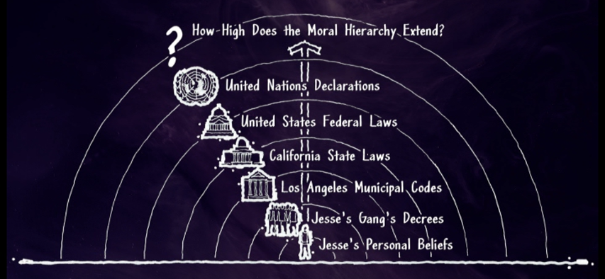
Do objective moral values and duties exist?
Jesse the gangster has his personal moral code.
Jesse’s gang has certain decrees that have hierarchy over Jesse’s personal moral code.
Los Angeles’ municipal codes have hierarchy over Jesse’s gang’s decrees.
California’s state laws have hierarchy over Los Angeles’ municipal codes.
The United State’s federal laws have hierarchy over California’s state laws
The United Nations declarations have hierarchy over the United State’s federal laws.
Are there objective moral laws that have hierarchy over all people?

Slide 4
Do objective moral values and duties exist?
The reality of objective moral truths is intuitive to us.
In his book On Guard, William Lane Craig refers to the work of Cambridge philosopher William Sorley.
“Sorley maintains that there is an objective moral order, which is as real and independent of us as is the natural order of things. He recognizes that in one sense we can’t prove that objective moral values exist, but he points out that in this same sense we can’t prove that the natural world of physical objects exists either! (You could be a body lying in the Matrix experiencing a virtual reality.) The moral order and the natural order are thus on a similar footing. Just as we assume the reality of the world of objects on the basis of our sense experience, so we assume the reality of the moral order on the basis of our moral experience.”

Slide 5
Do objective moral values and duties exist?
Even though moral perspectives may differ across history and cultures, there are certain core values that are constant.
"Men have differed as regards what people you ought to be unselfish to - whether it was only your own family, or your fellow countrymen, or every one. But they have always agreed that you ought not to put yourself first. Selfishness has never been admired.“ – C. S. Lewis
We can find some objective moral values by adding “for the fun of it” to some actions.
It can be argued that there are situations in which lying, stealing, or killing is morally permissible.
But is it never ok to lie, steal, or kill “for the fun of it”.

Slide 6
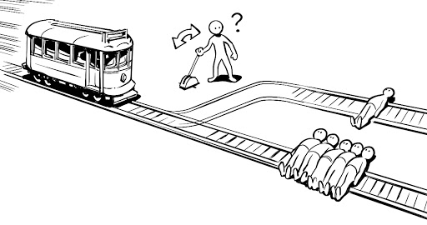
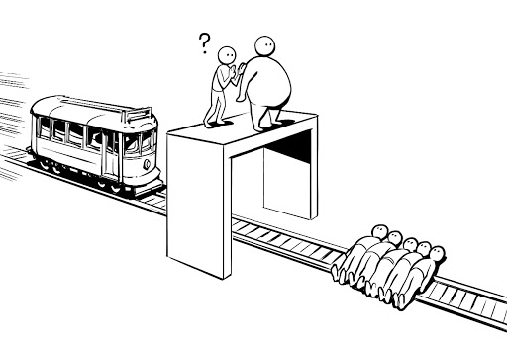
Do objective moral values and duties exist?
There are a series of moral thought experiments called the Trolley Problems.
Imagine a runaway trolley hurtling down some tracks toward 5 people.
You are next to a switch that will divert the trolley to a side track, but there is 1 person on the side track. Do you let 5 people die? Or do you flip the switch and let 1 person die?
Most people would flip the switch.
Imagine a similar scenario, except instead of a switch, you are on a bridge with a very large man who would derail the trolley if you pushed him onto the track. Do you kill the 1 man to save 5 people?
Most people would not push the man.

Slide 7
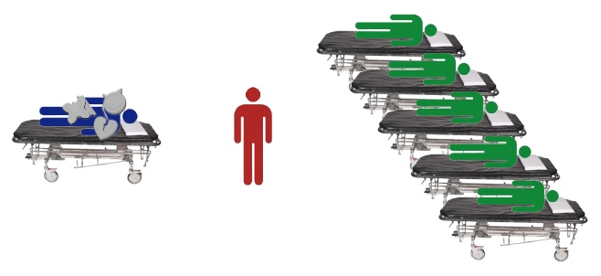
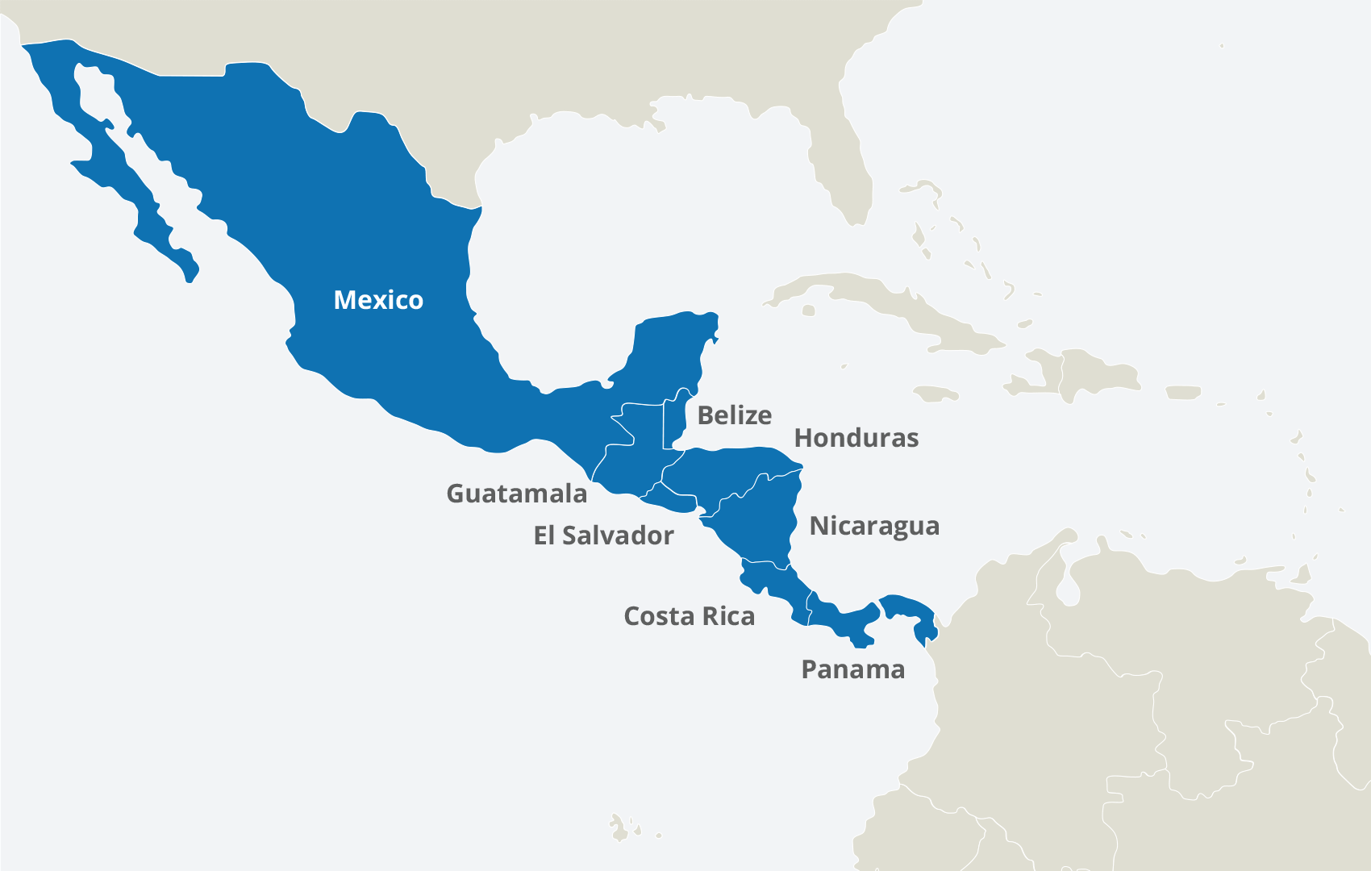
Do objective moral values and duties exist?
Now imagine a surgeon who has 5 patients that desperately need a different organ each. In a nearby waiting room, the surgeon sees a healthy man with healthy organs that would save the 5 patients. Should the surgeon kill the healthy man to save the lives of 5 others?
Most people would say no.
In his book The God Delusion, Richard Dawkins writes about the Harvard biologist Marc Hauser who presented a form of these thought experiments to the Kuna tribe, an isolated tribe in Central America with no formal religion. Dawkins writes that the results showed that “the Kuna show the same moral judgments as the rest of us.”
People have a common, built-in sense and experience of moral truths.

Slide 8
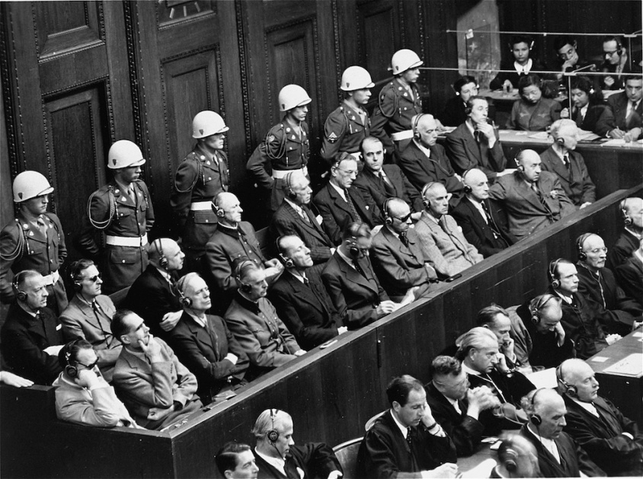
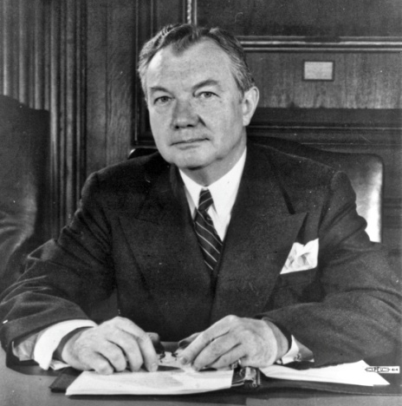
Do objective moral values and duties exist?
After WWII, Nazis went on trial for crimes against humanity and war crimes at Nuremberg.
The Nazis’ defence was that they had acted according to the laws of their nation, so what they did was morally acceptable.
If morality is simply the preferences of a culture, then we would have no basis for condemning the beliefs and actions of the Nazis.
In response, Robert H. Jackson, the chief counsel of the US, argued that there was a “law above laws”. This Law is greater than the laws of a nation or an individual, and applies to every person everywhere. And the Nazis were found to be guilty of breaking this Law and were judged accordingly.

Slide 9
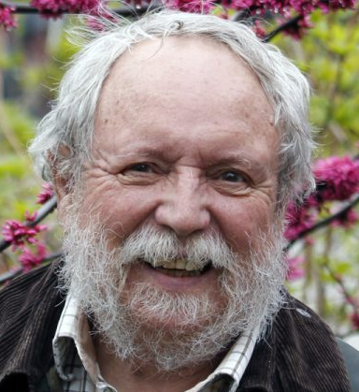
Do objective moral values and duties exist?
Many atheists will agree that objective moral truths exist.
"The man who says that it is morally acceptable to [abuse] little children is just as mistaken as the man who says that 2 + 2 = 5." - Michael Ruse, atheist philosopher of science.
“Some moral views are true, others false, and my thinking them so doesn’t make them so. My society’s endorsement of them doesn’t prove their truth. Individuals, and whole societies, can be seriously mistaken when it comes to morality. The best explanation of this is that there are moral standards not of our own making.” - Russ Shafer-Landau, atheist philosopher.
“Any argument for moral skepticism will be based upon premises which are less obvious than the existence of objective moral values themselves.” - Louise Antony, atheist philosopher.

Slide 10
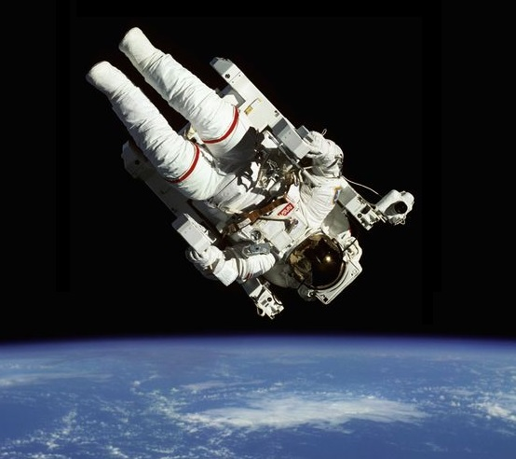
Where do objective moral values and duties come from?
An objective judgment requires a standard – a reference point.
Any time we make a moral judgment that one action is better than another, we are using a reference point in order to make that judgment.
Philosopher William Lane Craig uses an example of an astronaut floating in space. Unless she finds a point of reference, she has no way of knowing which way is up.
C. S. Lewis understood that all his moral judgments needed an objective standard, even as an atheist. "My argument against God was that the universe seemed so cruel and unjust. But how had I got this idea of just and unjust? A man does not call a line crooked unless he has some idea of a straight line. What was I comparing this universe with when I called it unjust?“

Slide 11
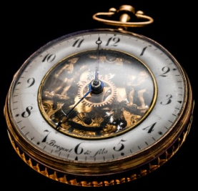
Where do objective moral values and duties come from?
There once was a man who ran a newspaper stand on the sidewalk. He had a large clock hanging on the side of his stand.
Early each morning, a second man would walk past the newspaper stand and set his watch according to the time on the clock.
One day, the first man asked the second man, “Why do you stop each day and set your watch according to my clock?”
The second man said, “I am the foreman of the factory down the road. It is my job to ring the bell at exactly 5pm each day to alert the workers that their shift is over. My watch keeps time poorly, so I set it each morning to make sure I have the correct time.”
The first man said, “I have some bad news for you. My clock is slow, so when I hear the factory bell ring each day I set my clock to 5pm.”
Both men were missing a reference point for their clocks. Their measure of time was unreliable because it lacked an objective foundation.

Slide 12
Where do objective moral values and duties come from?
So we can see that unchanging, objective moral truths need an unchanging, objective standard. This standard provides the foundation for us to base our moral judgments upon.
But there’s more. Moral duties only apply to people. There are no moral obligations between objects, or even animals.
"A hawk that seizes a fish from the sea kills it, but does not murder it; and another hawk that that seizes that fish from the talons of the first takes it, but does not steal it - for none of these things is forbidden." - Richard Taylor, non-Christian ethicist.
The actions of animals have no moral dimension to them. Only humans feel the weight of this objective Moral Law to which we ought to align our behaviours.

Slide 13
Where do objective moral values and duties come from?
Since moral laws exist between persons and are transcendent, it seems reasonable for us to look for the transcendent Person to whom we are ultimately obligated.
If such a Being exists, moral truths would be a reflection of His nature. His nature provides the objective, unchanging, transcendent standard for moral values, and His commands provide us with our moral duties.
An action can be called moral if it aligns with the Being’s nature, and immoral if it goes against the Being’s nature.

Slide 14
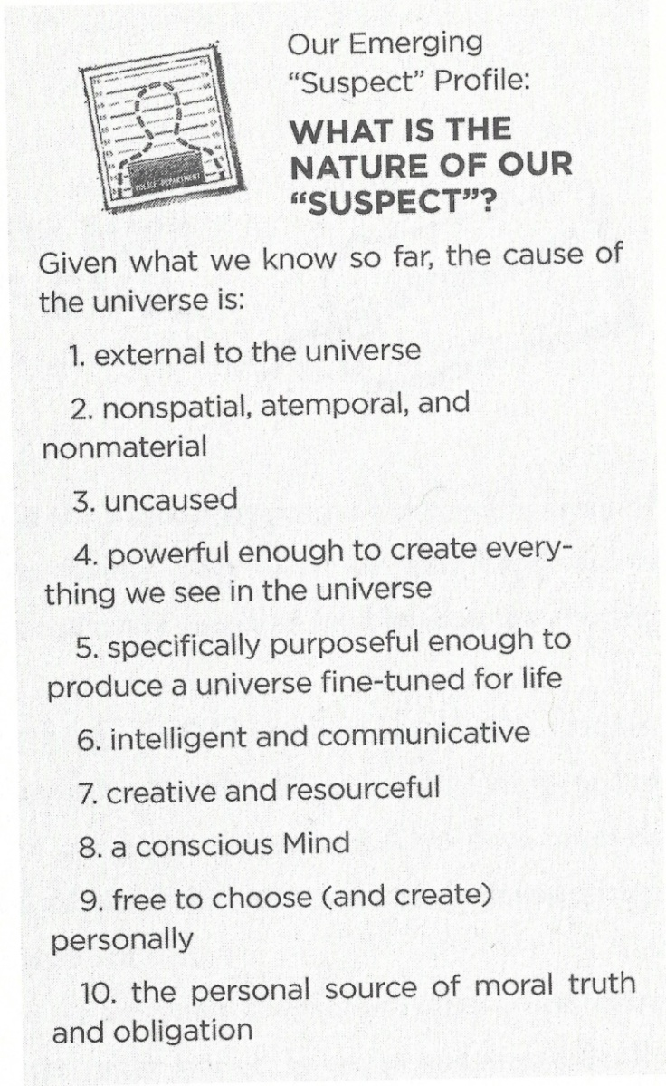
Our Suspect Profile
Origin of the universe
Fine-tuning of the universe
Information in DNA
Design in biology
Existence of consciousness
Existence of free will
Objective morality

Slide 15
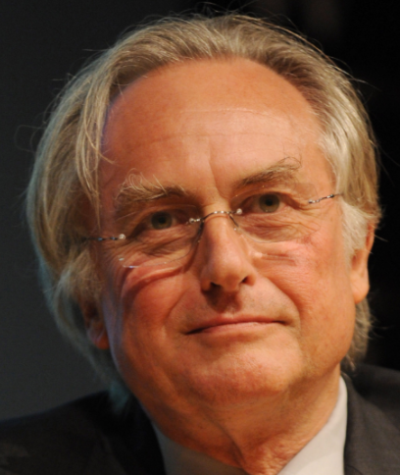
Objections
Morality is an illusion. Moral truth does not exist at all.
“The universe we observe has precisely the properties we should expect if there is, at bottom, no design, no purpose, no evil, no good, nothing but blind, pitiless indifference.” – Richard Dawkins, atheist biologist
There is no need to explain where morality came from because moral claims are not true or false. They simply describe how we feel about certain things in the universe.
This is just a “dodge” by attempting to redefine what we mean by “morality”. Moral truth cannot be ignored or defined. Even someone who is making this objection will make moral judgments as part of everyday life.
Also, notice how often some atheists dismiss things they can’t explain as just illusions? Rather than believe in God, they would have us believe that our biological design, our minds, our free will, and our moral sense are all illusions. This is a non-explanation that just acts as a dismissal of things that don’t fit into their worldview. A naturalistic worldview is woefully inadequate to explain reality.

Slide 16
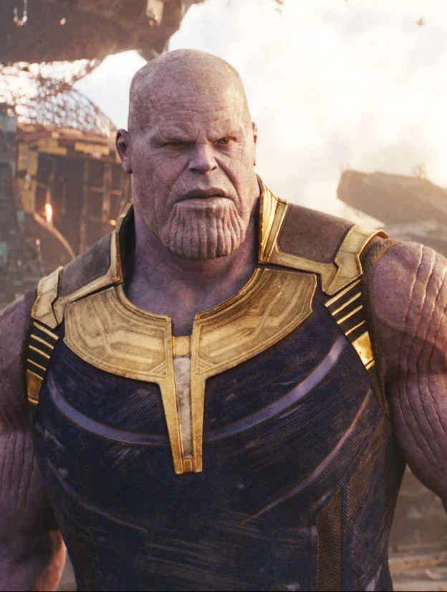
Objections
- Act Consequentialism:
An action can be considered moral if it leads to a good outcome. The end justifies the means. For example, murder is bad because it leads to someone dying for no reason. But killing a certain person to end a war or save hostages is good because it saves many more lives.
In the movie Avengers: Infinity War, a villain called Thanos is on a quest to obtain a weapon that will let him wipe out half of life in the universe with a snap of his fingers.
He believes that he is morally justified in doing this because he watched his home planet use up its resources until people starved to death. He will stop at nothing to reach his goal and restore “balance” to the universe, allowing the remaining life to flourish with abundant resources.
Eventually, Thanos actually gets the weapon and manages to wipe half of all living things in the universe out of existence. But now the survivors have more than enough food and water to go around, and the next generations to come will enjoy that abundance.
Did Thanos do a good thing?

Slide 17
Objections
- Act Consequentialism:
A woman I talked with online argued that abortion is a good thing because it allows fetal stem cell research which can save lives. In fact, she said I was hypocritical to be pro-life and stand against abortion.
But most people intuitively know that an immoral act is still immoral even if some good can come out of it. As we saw with the Trolley Problems, most people would not push a large man in front of a trolley, even if means saving 5 others. We can see that a direct act of killing an innocent person is wrong, even if it ends up causing something good.
I argued to the woman online that if someone was hanging off a cliff and I murdered a nearby man to use his entrails as a rope to pull the first man to safety, I would still be guilty of murder, even though my murderous act led to the first man’s survival. Even if 100 people had been saved, murder is still murder.
Also, the idea of act consequentialism relies on moral judgments. How can we say that an act had a good outcome unless we already have a sense of goodness to know what a good outcome is?

Slide 18
Objections
We evolved our sense of morality because morality helps us survive.
In his book Stealing From God, Frank Turek gives 6 points against this idea:
This is a category mistake. You can't explain an immaterial moral law with a material biological process. Justice is not made of molecules. Also, moral laws are prescriptive, biological processes are descriptive and have no authority to tell you what to do.
Biology describes what does survive, not what ought to survive. There is no real "good" to evolution. It is simply a matter of survival. Should a person murder if it helps her survive? Should a person propagates his DNA at any cost?
Survival is not the highest moral virtue. Sacrificing oneself to save another is the highest form of morality and love.
Since evolution is a process of change, morality should also change. On evolution, morality cannot be objective and unchanging, so murder could one day be considered "good".
Even if evolution gave us a "social contract" that we call morality, I am not immoral for breaking that contract. To judge someone as wrong for not following an evolutionary contract would be to appeal to a moral law beyond the "social contract".
Many people survive and even prosper without cooperating with other people. Dictators often live quite nicely. Joseph Stalin murdered millions and then died comfortably from old age. There is nothing necessary about morality for survival.

Slide 19
Objections
We evolved our sense of morality because morality helps us survive.
In the movie Man of Steel, Superman is fighting General Zod and his army of Kryptonians. One of these Kryptonians is a woman called Faora-Ul.
She is busy fighting Superman and notices that he has a moral code. He cares about humans and constantly tries to save them while he’s battling the powerful Kryptonians. He values life and does all he can to avoid killing.
Faora-Ul says to Superman, “You are weak, son of El. The fact that you possess a sense of morality and we do not gives us an evolutionary advantage. And if history has proven anything, it is that evolution always wins.”
She’s absolutely right. Evolution favours the creatures that are more apt to survive. This means that the strongest or most intelligent creatures will become the dominant species on Earth. There is no reason to think that a species that somehow evolved some ingrained sense of right and wrong are better suited to survive over a species that simply destroys others for its own selfish benefit.

Slide 20
Objections
Atheists can also live moral lives, sometimes even more so than religious people. We clearly don’t need to believe in God in order to be moral.
Our argument is not that one must believe in God in order to be moral. It is clearly evident that atheists can live good, caring, loving lives. Our argument is that without God there would be no objective basis on which to ground morality.
Without God’s existence, we would need to find a transcendent, objective foundation for moral truths out of matter, energy, physics, and chemistry. This simply cannot be done.
The Bible says that God has written His law on our hearts.
“For when Gentiles, who do not have the law, by nature do what the law requires, they are a law to themselves, even though they do not have the law. They show that the work of the law is written on their hearts, while their conscience also bears witness, and their conflicting thoughts accuse or even excuse them on that day when, according to my gospel, God judges the secrets of men by Christ Jesus.” – Romans 2:14-16
Even if someone denies the existence of God, God has still given them a moral conscience. They still feel the weight of the Moral Law, even though they reject the Moral Lawgiver.

Slide 21
Objections
Morality is subjective. It changes over time as the majority opinion of people shifts. People are the ultimate source of “right” and “wrong”, based primarily on our subjective feelings.
There are several problems with this idea:
We often know that the right course of action is one that we don’t actually want to do. Our feelings do not dictate moral realities. If I find a wallet full of cash, I know that the right thing to do is to try to find its owner, even though I may actually want to keep the cash.
This idea eliminates moral debate. We can no longer disagree with people about moral issues because each person determines their own moral laws. There would be no objective framework available to allow us to say that someone has done something morally wrong. How could we say that Mother Teresa lived a better life than Hitler?
This idea leads to moral selfishness. If moral truth is rooted in the beliefs and opinions of subjects, why should anyone care about others beyond himself or his own family?
No one actually lives like morals are subjective, even the people who claim that they are.
“Whenever you find a man who says he does not believe in a real Right and Wrong, you will find the same
man going back on this a moment later. He may break his promise to you, but if you try breaking one to
him he will be complaining ‘It’s not fair’ before you can say Jack Robinson. “ – C. S. Lewis.

Slide 22
Objections
Morality is based on human flourishing. If behaviour leads to humans flourishing, then that behaviour can be called objectively good.
What do they mean by “flourishing”?
If they mean “survival”, we can think of some immoral behaviours that can help a group’s survival, like owning slaves or stealing resources from other people groups.
If they mean “well being”, then why should we care about people’s well-being? They are smuggling in a moral judgment in their quest to find a foundation for morality. They start with morality in order to ground morality.
Also, why should we care specifically about the flourishing of humans? Is this not “species-ist”? Why not care about the flourishing of rats? Or cabbages?
In the movie Batman v Superman, atheist Neil deGrasse Tyson says, “[On] Darwinian evolution, you find out that we're not special on this Earth. We're just one among other life-forms.”

Slide 23
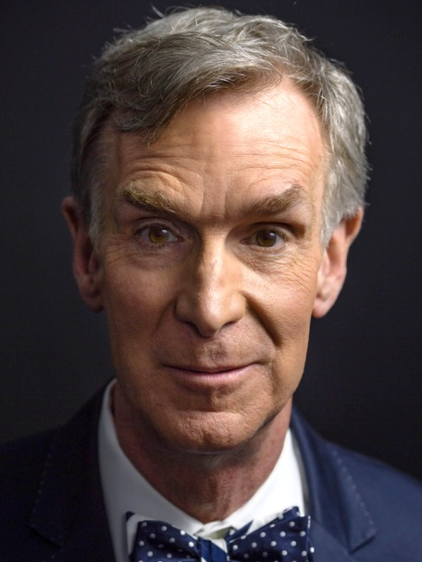
Objections
Morality is based on human flourishing. If behaviour leads to humans flourishing, then that behaviour can be called objectively good.
Bill Nye (atheist) said in a 2010 speech for the American Humanist Association, “I am not that different from a grain of sand. I am insignificant...I am just another speck of sand. And the earth really, in the cosmic scheme of things, is another speck. And the sun, an unremarkable star... is another speck. And the galaxy is a speck. I'm a speck on a speck, orbiting a speck, among other specks, among still other specks, in the middle of specklessness! I am nothing. I am insignificant. I suck!“
On a naturalistic worldview, there is no justification for the intrinsic value of human life, as atheists themselves often admit. They say that there is nothing significant about human life, and yet they would have us believe that human flourishing provides a foundation for objective morality.

Slide 24
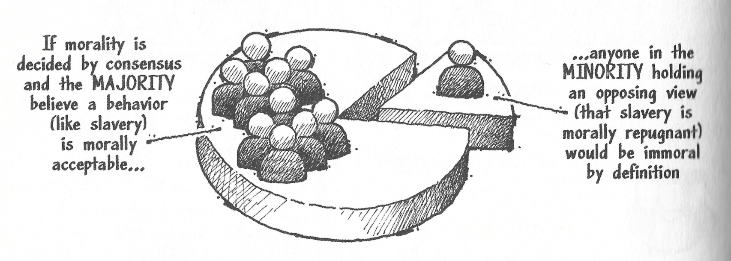
Objections
Moral truths are a product of culture. People groups create their moral laws by consensus opinion.
If moral truth is determined by societies and cultures, how can any one group logically argue about which culture has better values, or condemn a culture for holding an abhorrent belief or performing immoral actions?
If consensus opinion determines moral truths, then any minority group that opposes those “moral truths” would be immoral by definition. But moral reform often starts off as a minority opinion, such as the liberation of slaves or the equality of coloured people.

